Slide 1
Metasploit-Framework For Penetration Testing

Slide 2
About Me:
Manish Sharma
>> Github: https://github.com/z3a70t
>> LinkedIn: https://www.linkedin.com/in/manish-sharma-b84699183
>> Twitter: @ManishS34838340

Slide 3
Agenda
History
Why Metasploit-Framework
Configuration
Modules
Conclusion

Slide 4
History
In 2003: H. D. Moore, a portable network tool using Perl.
By 2007: Rewritten in Ruby.
On October 21, 2009: Metasploit project announced – acquired by Rapid7
Rapid7 is Unified Vulnerability Management Solution.

Slide 5
Why Metasploit-Framework
It is Open-Source and free to use.
Used to test vulnerability of a Computer System.
To Break to remote System.
It can be used for both legitimate and unauthorized activities.
de facto exploit development framework.
To discover software vulnerability
Exploiting a known vulnerability
Metasploit-Framework:
1. msfconsole, 2. msfvenom, 3. armitage (GUI)

Slide 6
Configuration

Slide 7
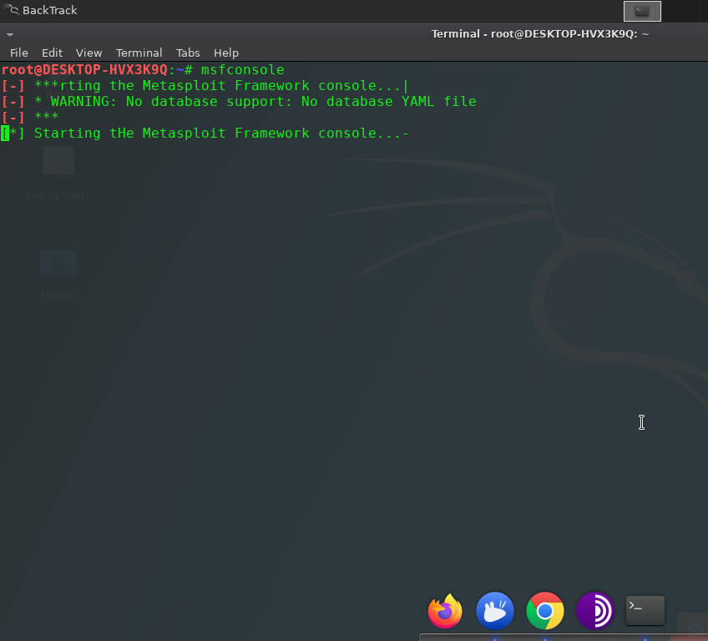
No database ?

Slide 8
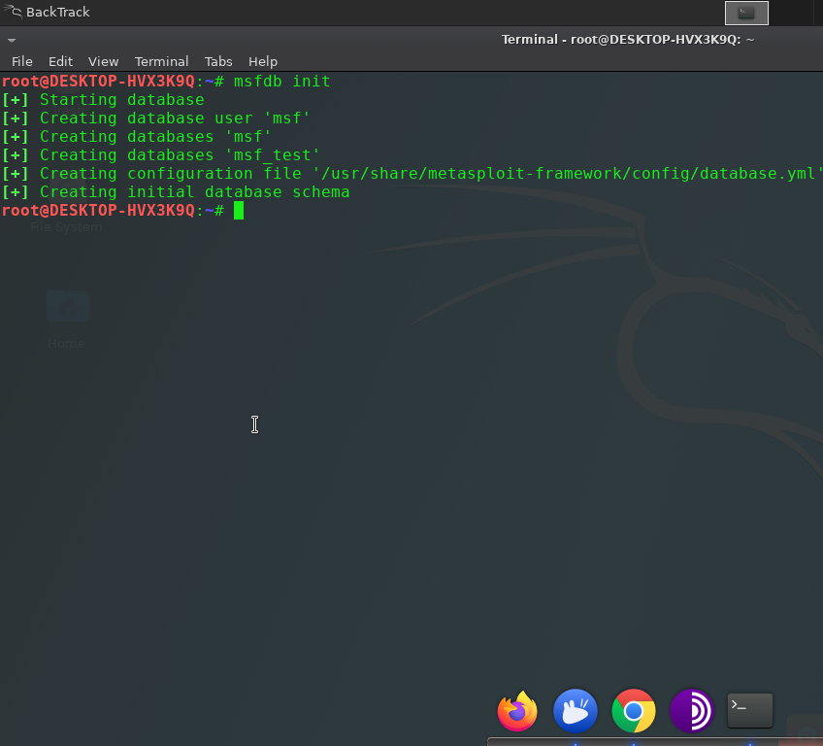
Initialize database

Slide 9
Don't Forget To Start Postgresql service
user@host :~# service postgresql start

Slide 10
Run Commands Within msfconsole

Slide 11
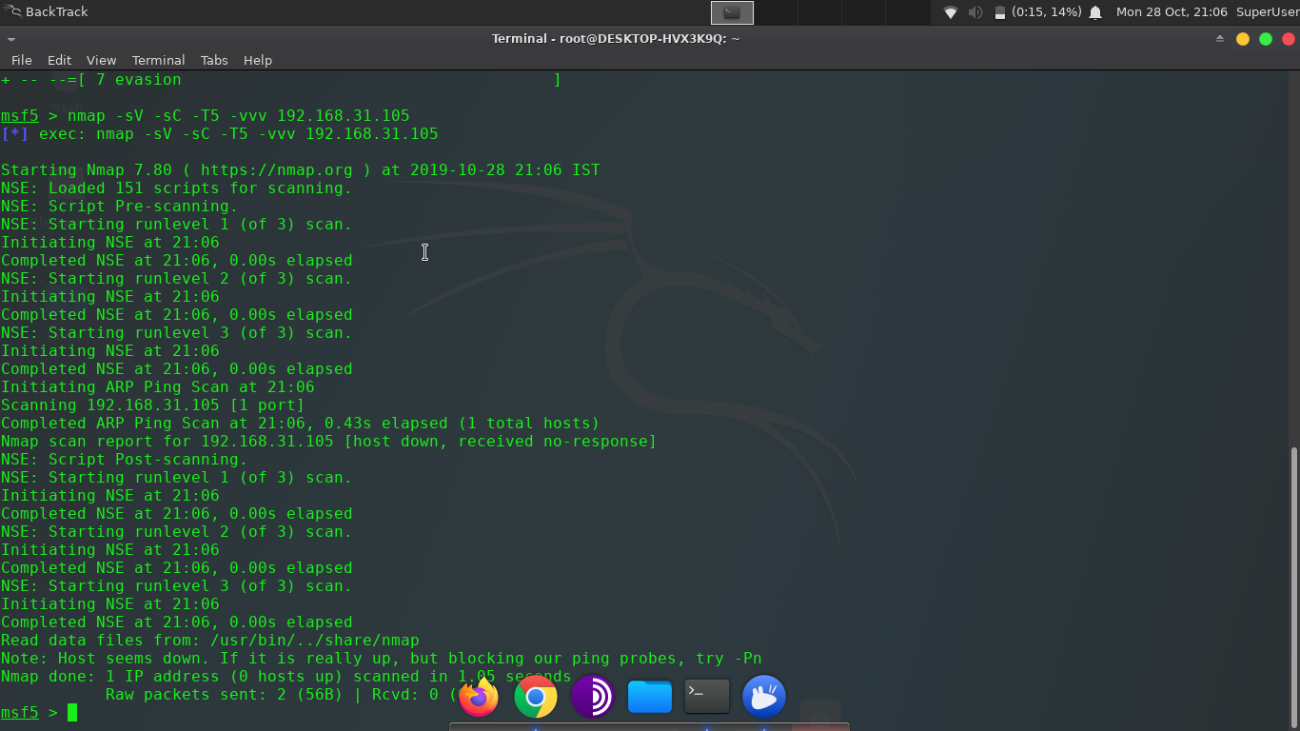

Slide 12
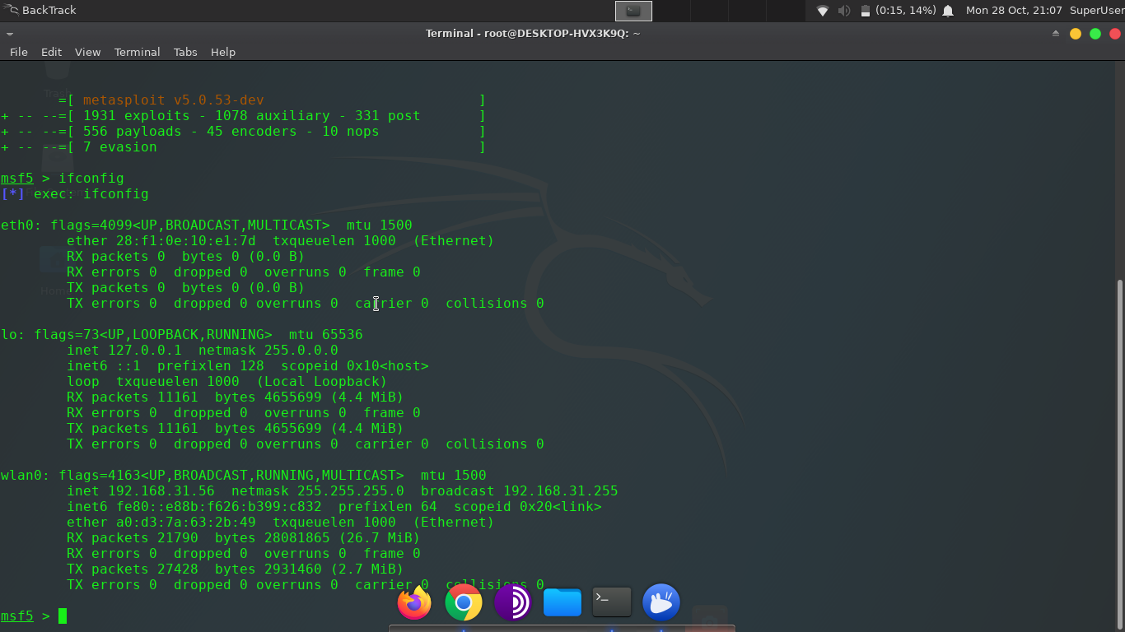

Slide 13
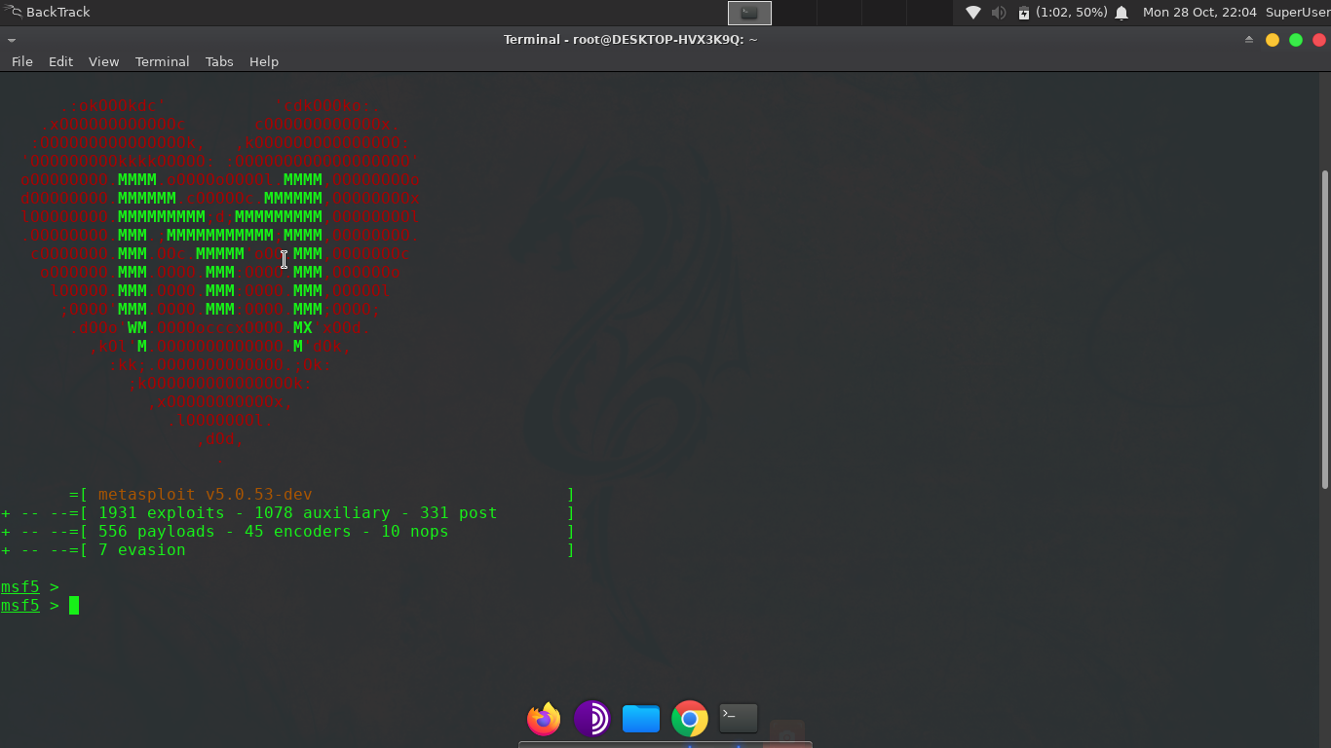

Slide 14
Modules in msfconsole
Exploits : 1931
Auxiliary : 1078
Post : 331
Payloads : 556
Encoders : 45
NOps : 10
Evasion : 7

Slide 15
Exploits
Falls into two parts: Active and Passive
Active: exploit a specific host, run until completion, and then exit.
Brute-force modules will exit when a shell opens from the victim.
Module execution stops if an error is encountered.
Passive: Wait for incoming hosts and exploit them as they connect.
Always focus on clients such as web browsers, FTP clients, etc.
Also be used in conjunction with email exploits, waiting for connections.

Slide 16
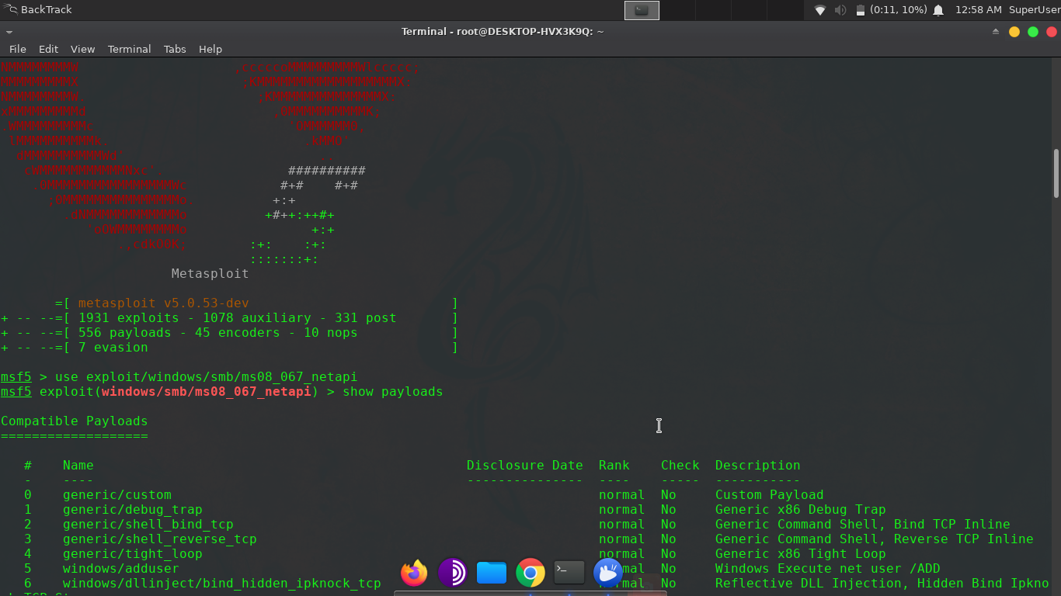

Slide 17
Auxiliary
Any module that is not an exploit is an auxiliary module.
Although these modules will not give us a shell, though helpful for Pentesting.
Perform scanning, fuzzing, sniffing, and much more.
Admin Modules: HTTP, MSSQL, MYSQL, etc.
Scanner: MSSQL, HTTP, MYSQL, POP3, SMB, SSH, etc.
Server Capture Modules too.

Slide 18
Post
Post-Exploitation Modules.
Run on compromised target.
Gather evidence, pivot deeper into a target network, and much more.
For Windows, Linux, OSX, Multiple OS.

Slide 19
Payloads
Three types: Single, Stager, Stages.
Single: That are self-contained and completely standalone.
Stager: Setup a network connection between the attacker and victim.
Are designed to be small and reliable.
Stages: Payload components that are downloaded by Stagers modules.
Such as Meterpreter, VNC Injection, and the iPhone 'ipwn' Shell.
Payload types: Inline, Staged, Meterpreter, Reflective DLL Injection, etc.
Eg. msf > use payload/windows/shell/bind_tcp

Slide 20
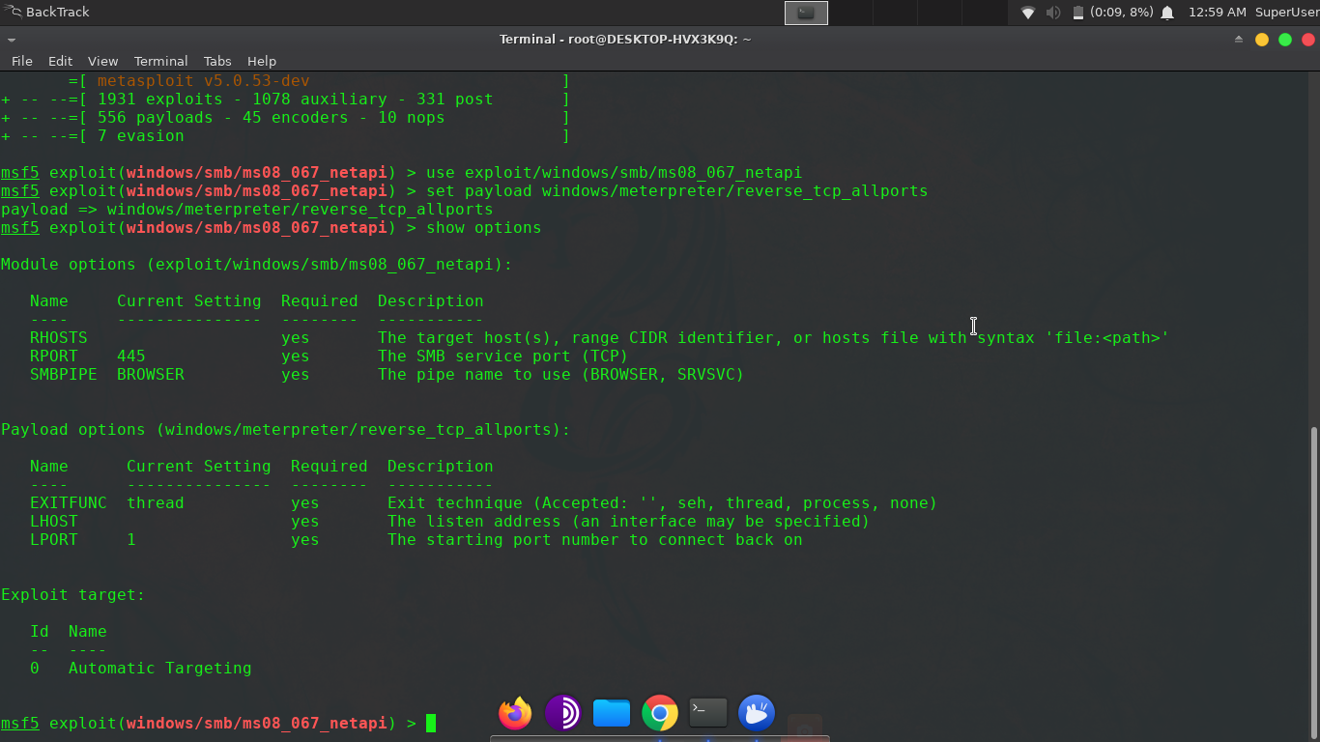

Slide 21
Meterpreter
Dynamically extensible payload
Uses in-memory DLL injection stagers
Extended over the network at runtime
Communicates over the stager socket
Provides a comprehensive client-side Ruby API
Utilizes a channelized communication system.
Features command history, tab completion, channels, and more.
It is Stealthy, Powerful and Extensible.
Like download, upload, hashdump and much more.

Slide 22
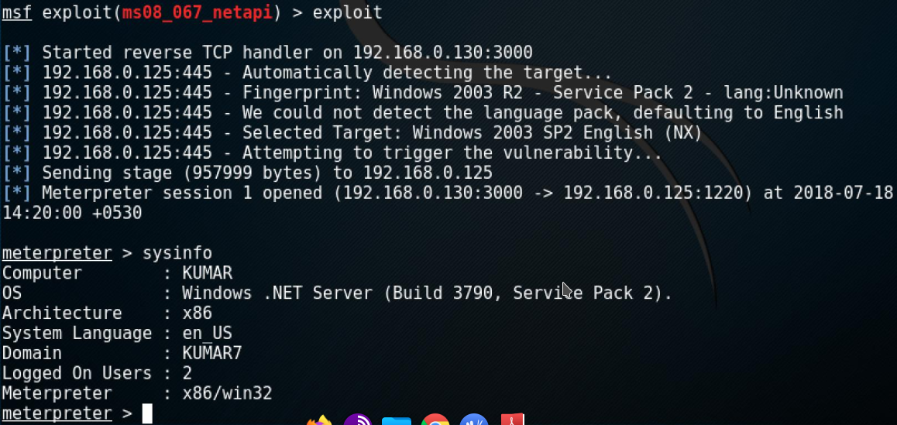

Slide 23
Encoders
Bypasses Detection.
Transforming your shellcode into pure alphanumeric.
Getting rid of bad characters or encoding it for 64 bit target.
Encode shellcode multiple times.

Slide 24
NOps
No Operations.
The defined Payload Space is 900 bytes
The Payload is 300 bytes long
The Encoder stub adds another 40 bytes to the payload
The NOPs will then fill in the remaining 560 bytes bringing the final payload.encoded size to 900 bytes

Slide 25
Evasion
Introduced in Metasploit-5
Help to create payloads that can evade anti-virus (AV) software.

Slide 26
Conclusion
>> System Hacking
>> Checking strenght of Network
>> Scanning, Fuzzing, Sniffing
>> Use your own exploits
>> Evading Anti-Virus

Slide 27
ThankYou

